Slide 1
LHN Maintenance District November 12, 2019

Slide 2
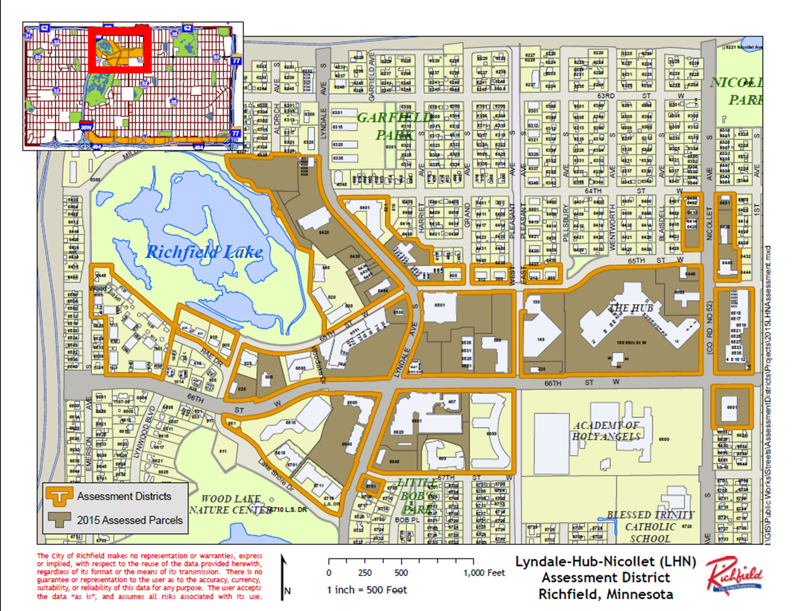

Slide 3
Whether to Continue the LHN Maintenance District?
Keeping the District?
Original/special design elements
Redevelopment
Maintenance Agreements
Current Services outside of the District
Informal petitions
Dissolving the District?
Current Charges
Future Charges
City Staff Time
Adjacent property owner responsibilities
Notes:
-Providing a higher level of maintenance (1981)
-Averaging $25,000/year
-$9,800 Street and Park budgeted expenses to LHN
-

Slide 4
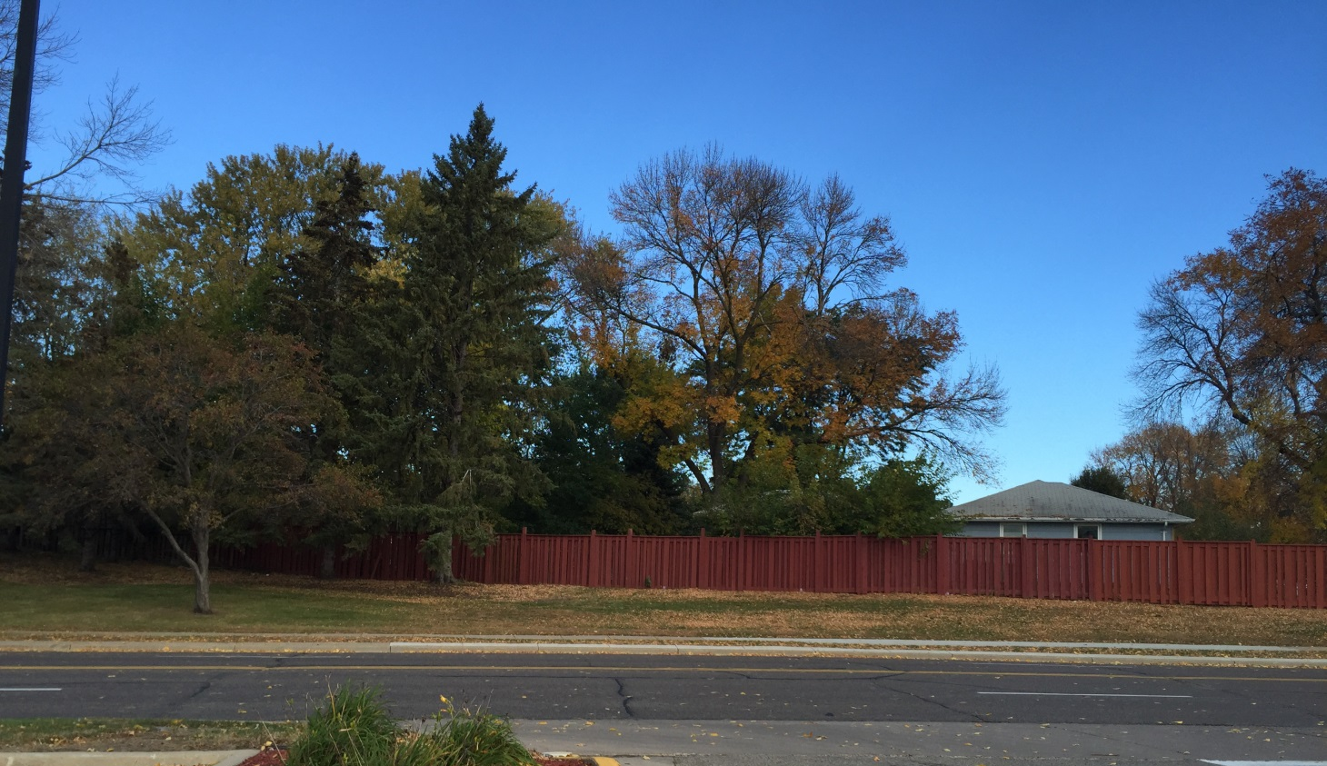
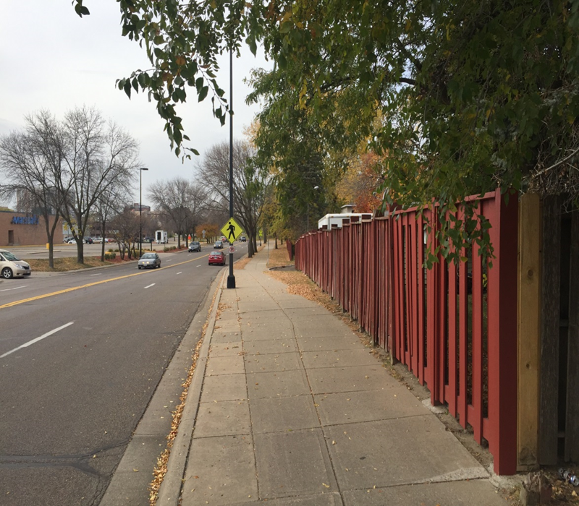
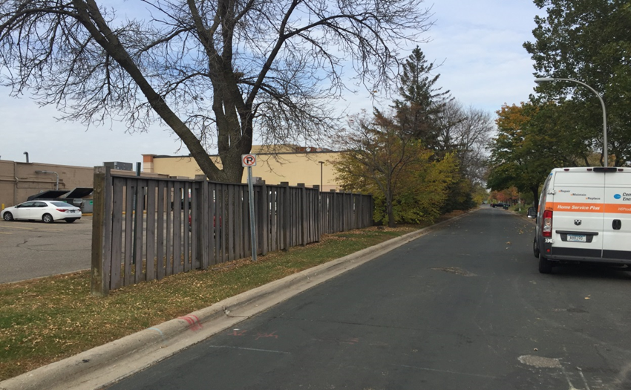
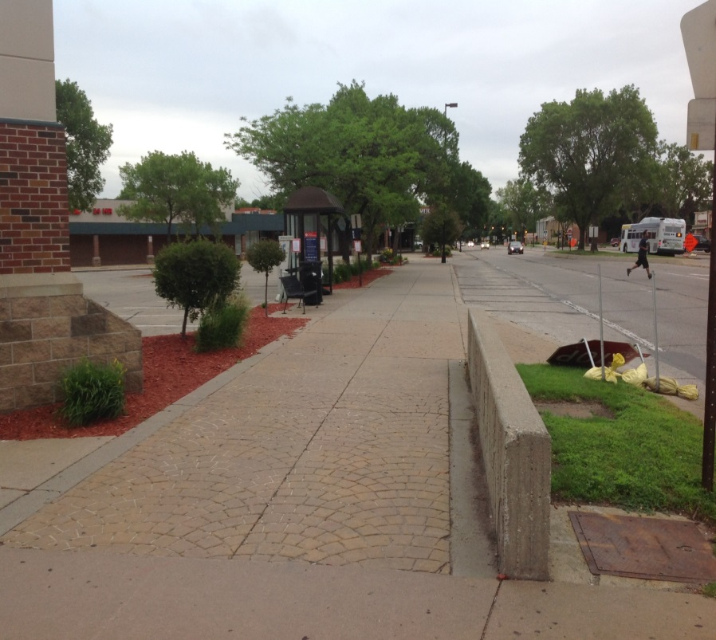

Slide 5
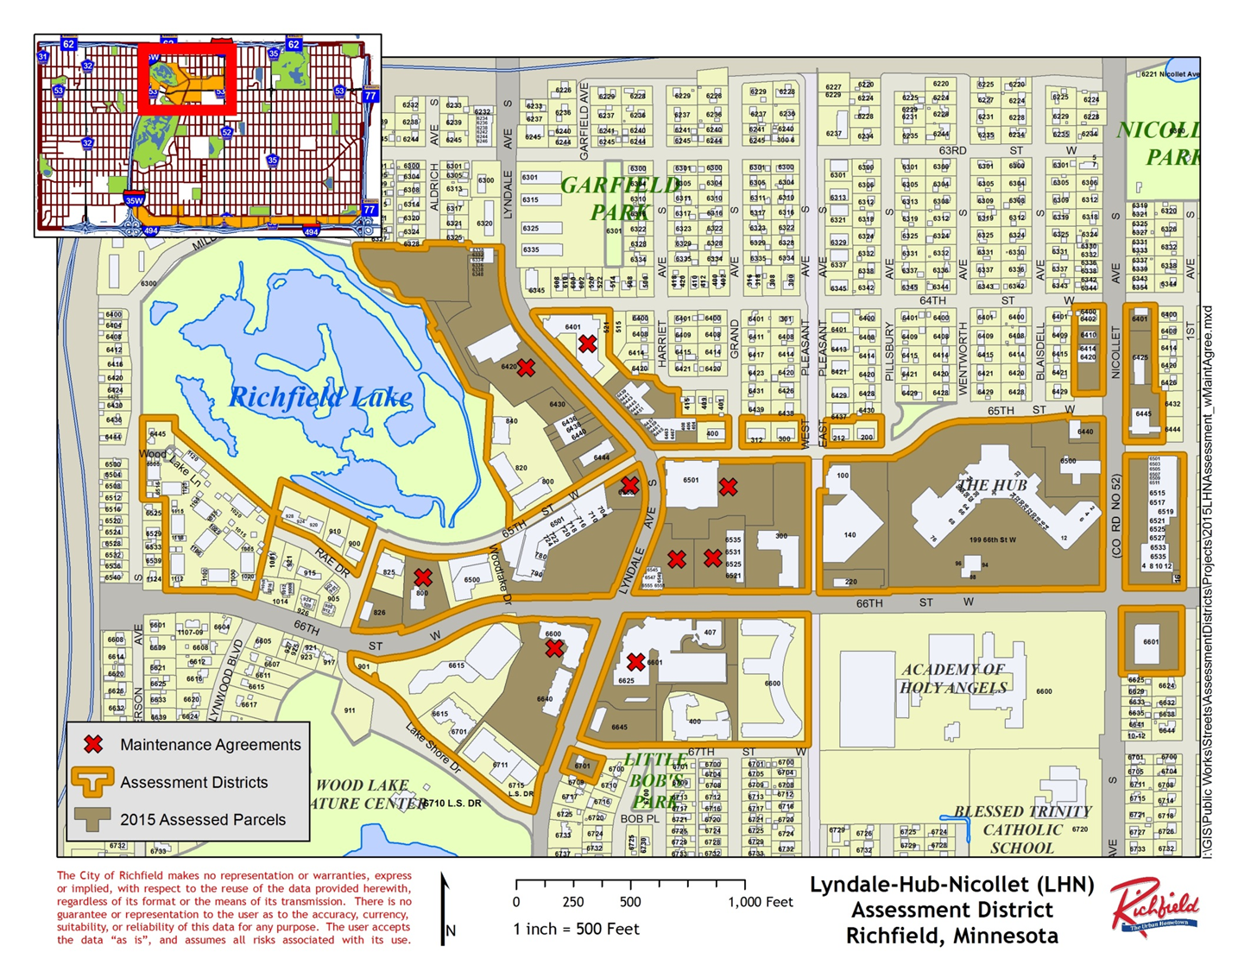

Slide 6
New Maintenance Agreement
Public Area Feature | Ownership | Construction and Installation Responsibility | Maintenance, Repair, Replacement Responsibility | Responsible for the Cost of Operation & Maintenance | Inspection & Maintenance Cycle
Sidewalk | City | Developer | City | City | Annually
Sidewalk Snow Removal | City | N/A | See Paragraph 5 | See Paragraph 5 | As needed
Landscaping | Developer | Developer | Developer | Developer | As needed
Private Irrigation | Developer | Developer | Developer | Developer | As needed
Public Utilities (Storm, Sewer, Water) | City | Developer | City | City | As needed
Environmental Manhole (Sump Manhole) | Developer | Developer | City | Developer | Annually
Pedestrian Sidewalk Lighting | City | Developer | City | Developer | As needed
Street Lighting | City | Developer | City | City | As needed
Boulevard Trees | City | Developer | City | City | As needed

